Slide 1
1
Chapter 10: Infections & related conditions
NATIONAL DEPARTMENT OF HEALTH
AFFORDABLE MEDICINES
ESSENTIAL MEDICINES PROGRAMME
PRIMARY HEALTHCARE GUIDELINES 2018

Slide 2
2
EVIDENCE
Please access the National Essential Medicines List Committee (NEMLC) report for detailed evidence (including rationale, references and costings) informing decision-making on medicine addition, amendments and deletions:
http://www.health.gov.za/index.php/standard-treatment-guidelines-and-essential-medicines-list/category/285-phc
DISCLAIMER
This slide set is an implementation tool and should be used alongside the most recently published STG available on the EML Clinical Guide Application. This information does not supersede or replace the STG itself.

Slide 3
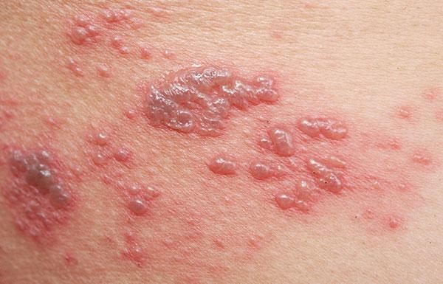
3
Shingles (herpes zoster)
DESCRIPTION
Dermatomal eruption of vesicles on an erythematous base due to varicella zoster virus
CHANGES
SHINGLES guideline ADDED (previously only in HIV chapter)
Pain management (paracetamol & tramadol for severe cases) & amitriptyline for post herpetic neuralgia
REASON
Condition commonly presents at primary level of care

Slide 4
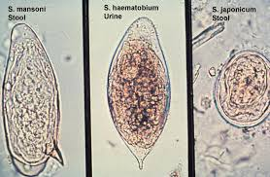
4
Schistosomiasis (bilharzia)
DESCRIPTION
Parasitic infestation with either Schistosoma haematobium (bladder and renal tract), or Schistosoma mansoni (intestinal tract)
Infestation occurs during washing, bathing or paddling in water harbouring snails shedding this parasite
CHANGES
Retreatment of schistosomiasis with repeated doses of praziquantel in persistent bleeding requires referral
REASON
Diagnosis to be verified through laboratory tests

Slide 5
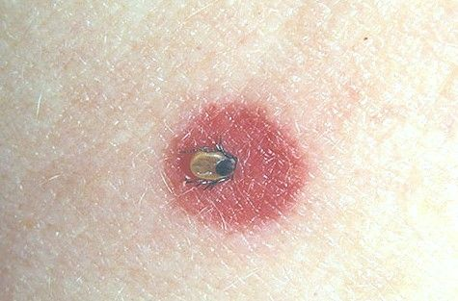
5
Tick bite fever
DESCRIPTION
Tick-borne infection due to Rickettsia conorii (from dogs) or Rickettsia africae (from cattle and game)
Classic triad of fever, eschar and rash occurs in 50-75% of patients.
CHANGES – new STG
Azithromycin, oral 10 mg/kg daily for 3 days recommended for children < 45 kg ADDED
Doxycycline 100 mg daily for 3 days for children ≥ 45 kg and adults ADDED
REASON
Condition is common & easily managed at PHC level
Azithromycin is effective & safe to use for children with mild to moderate tick bite fever
Cut-off of 45 kg used – aligned with international guidelines

Slide 6
THANK YOU

