Slide 1
1
Chapter 11: HIV and AIDS
NATIONAL DEPARTMENT OF HEALTH
AFFORDABLE MEDICINES
ESSENTIAL MEDICINES PROGRAMME
PRIMARY HEALTHCARE GUIDELINES 2018

Slide 2
2
EVIDENCE
Please access the National Essential Medicines List Committee (NEMLC) report for detailed evidence (including rationale, references and costings) informing decision-making on medicine addition, amendments and deletions:
http://www.health.gov.za/index.php/standard-treatment-guidelines-and-essential-medicines-list/category/285-phc
DISCLAIMER
This slide set is an implementation tool and should be used alongside the most recently published STG available on the EML Clinical Guide Application. This information does not supersede or replace the STG itself.

Slide 3
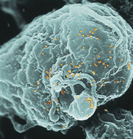
3
HIV infection in adults
DESCRIPTION
Eligibility and timing for ART
CHANGES
All HIV positive patients are eligible for ART, irrespective of CD4 count or WHO stage.
ART may be started on the same day if the patient has no clinical contraindication, and patient is willing to start.
Delay initiation in patients with cryptococcal meningitis or TB meningitis
REASON
RCTs and observational data show benefit of ART irrespective of CD4 count
Increased risk of death with immediate ART initiation in patients with cryptococcal/ TB meningitis

Slide 4
4
HIV infection in adults
DESCRIPTION
Isoniazid Preventive Therapy (IPT)
CHANGES
Once active TB has been excluded, duration of IPT amended to 12 months for ALL.
Except pregnant women:
If CD4 ≥ 100cells/microl: IPT deferred until after delivery
If CD4 < 100 cells/microl: active TB excluded with symptom screen, then give IPT
REASON
IPT for 12 months in patients initiating ART, without the need for a TST is based on data from a randomised controlled trial
Evidence of adverse fetal outcomes with intrapartum INH exposure from a RCT.

Slide 5
5
HIV infection in children
DESCRIPTION
Management of HIV Infected Children
CHANGES
Children are eligible for ART if there is a confirmed diagnosis of HIV infection, irrespective of CD4 count and WHO clinical stage.
REASON
Amended to align with Universal Test and Treat Approach

Slide 6
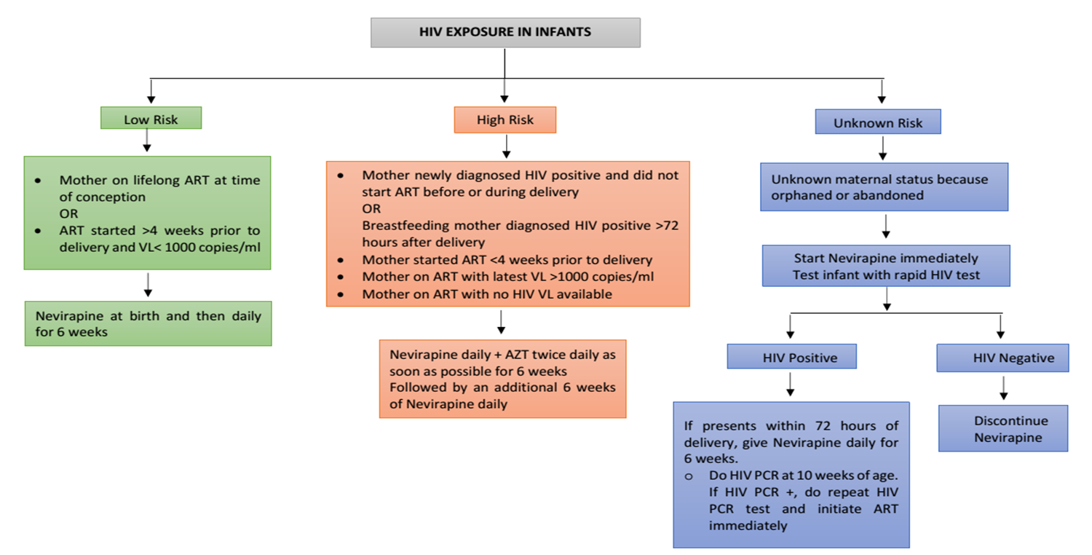
6
Treatment of HIV exposure in infants

Slide 7
THANK YOU

