Slide 1
1
Chapter 17: Respiratory conditions
[Insert title of meeting/event here]
[Insert name of presenter/unit here]
[Insert date of presentation here]

Slide 2
2
EVIDENCE
Please access the National Essential Medicines List Committee (NEMLC) report for detailed evidence (including rationale, references and costings) informing decision-making on medicine addition, amendments and deletions:
http://www.health.gov.za/index.php/standard-treatment-guidelines-and-essential-medicines-list/category/285-phc
DISCLAIMER
This slide set is an implementation tool and should be used alongside the most recently published STG available on the EML Clinical Guide Application. This information does not supersede or replace the STG itself.

Slide 3
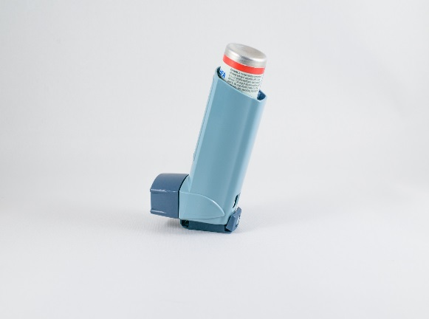
3
Chronic asthma and COPD
DESCRIPTION
A chronic inflammatory disorder with reversible airways obstruction
CHANGES
Budesonide ADDED and Beclomethasone REMOVED
Budesonide contra-indicated in patients on PIs – these patients should be referred for beclomethasone.
REASON
Budesonide is as effective as and cheaper than beclomethasone
Protease inhibitors increase blood concentrations of budesonide & fluticasone - could lead to Cushing’s syndrome

Slide 4
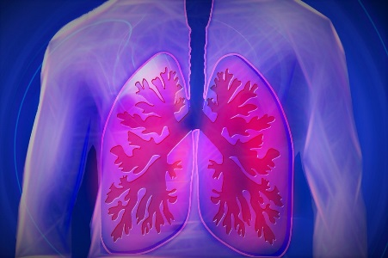
4
COPD
DESCRIPTION
Chronic bronchitis and emphysema which are characterised by chronic cough ± sputum, dyspnoea or shortness of breath and wheezing
CHANGES
Patients not controlled on salbutamol, but <2 exacerbations per year and COPD confirmed by spirometry: Formoterol (LABA without ICS) ADDED
All other COPD patients not controlled on salbutamol alone: LABA+ICS combination inhaler RETAINED
REASON
In asthma the risks of LABA alone without ICS is associated with increased mortality.
LABA alone must not be used unless the diagnosis of COPD has been confirmed by spirometry.

Slide 5
5
Acute bronchitis
DESCRIPTION
Acute airways infections, mostly of viral origin, accompanied by cough and sputum production, in patients with otherwise healthy lungs
CHANGES
Antibiotic treatment REMOVED
REASON
Antibiotics do not improve cure rates, even in HIV-infected patients

Slide 6
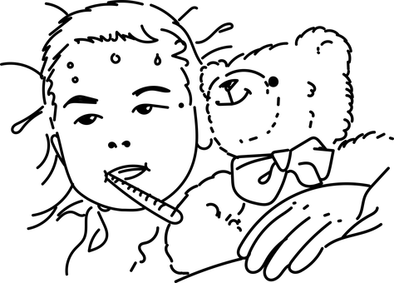
6
Pneumonia in children
DESCRIPTION
Acute infection of the lung parenchyma, usually caused by bacteria
CHANGES
Amoxicillin dose
AMENDED
from 8 hourly to 12 hourly
REASON
12 hourly dosing is as effective as 8 hourly dosing in children with pneumonia

Slide 7
THANK YOU

