Slide 1
1
Chapter 2: Gastro-intestinal conditions
NATIONAL DEPARTMENT OF HEALTH
AFFORDABLE MEDICINES
ESSENTIAL MEDICINES PROGRAMME
PRIMARY HEALTHCARE GUIDELINES 2018

Slide 2
2
EVIDENCE
Please access the National Essential Medicines List Committee (NEMLC) report for detailed evidence (including rationale, references and costings) informing decision-making on medicine addition, amendments and deletions:
http://www.health.gov.za/index.php/standard-treatment-guidelines-and-essential-medicines-list/category/285-phc
DISCLAIMER
This slide set is an implementation tool and should be used alongside the most recently published STG available on the EML Clinical Guide Application. This information does not supersede or replace the STG itself.

Slide 3
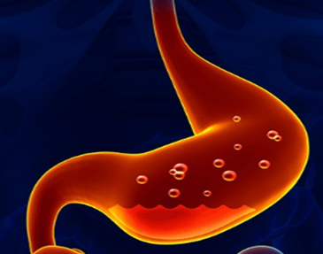
3
Dyspepsia, heartburn and indigestion, in adults
DESCRIPTION
Epigastric discomfort and minimal change in bowel habits.
CHANGES
Despite concerns over long-term Proton-Pump Inhibitor (PPI) use compared to antacids: Lansoprazole 30mg oral as first line, 14-day short-term therapy RETAINED
REASON
PPIs are cheaper and more effective than antacids
No evidence of harm at PHC level following short courses of PPIs

Slide 4
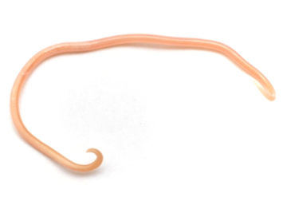
4
Helminthic infestation, excluding tapeworm
DESCRIPTION
Types of worm infestations:
Common roundworm, pinworm, hookworm and whipworm
CHANGES
Albendazole as a therapeutic alternative to mebendazole specifically for the commonly transmitted roundworm ADDED
REASON
There is evidence of comparable efficacy of mebendazole and albendazole for eradication of roundworm

Slide 5
5
THANK YOU

