Slide 1
1
Chapter 5: Skin conditions
NATIONAL DEPARTMENT OF HEALTH
AFFORDABLE MEDICINES
ESSENTIAL MEDICINES PROGRAMME
PRIMARY HEALTHCARE GUIDELINES 2018

Slide 2
2
EVIDENCE
Please access the National Essential Medicines List Committee (NEMLC) report for detailed evidence (including rationale, references and costings) informing decision-making on medicine addition, amendments and deletions:
http://www.health.gov.za/index.php/standard-treatment-guidelines-and-essential-medicines-list/category/285-phc
DISCLAIMER
This slide set is an implementation tool and should be used alongside the most recently published STG available on the EML Clinical Guide Application. This information does not supersede or replace the STG itself.

Slide 3
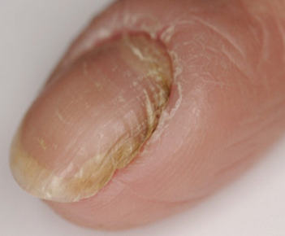
3
Chronic paronychia
DESCRIPTION
Chronic, red, swollen nailfold, lifted off the nail plate with whitish pus
Commonly caused by working in water and contact with household detergents
CHANGES
Topical antifungal DELETED
Potent topical corticosteroid ADDED (e.g. betamethasone 0.1% massaged into nail folds at night for 3 weeks)
REASON
Primary cause is eczema: corticosteroids are more effective than antifungals

Slide 4
4
Hypopigmentory disorders
DESCRIPTION
ALBINISM: Congenital disorder characterized by the complete or partial absence of pigment in the skin, hair and eyes.
VITILIGO: Autoimmune disease characterised by patches of the skin losing their pigment.
CHANGES
Guidance for management of HYPOPIGMENTORY DISORDERS ADDED
Zinc oxide cream to ADDED for ALBINISM
Titanium dioxide ointment/cream ADDED for ALBINISM
Titanium dioxide ADDED for VITILIGO: to be used ONLY when exposed to sunlight between 10:00 and 15:00
REASON
The PHC STGs should describe treatment for common skin disorders
Zinc oxide/ titanium dioxide used as a sunscreen
Moderate sun exposure is beneficial in VITILIGO

Slide 5
5
Atopic eczema & seborrhoeic dermatitis
DESCRIPTION
Acute flare of atopic eczema and seborrheic dermatitis
CHANGES
Potent topical corticosteroids (eg betamethasone 0.1%) AMENDED from twice to once daily
REASON
Once daily application of potent topical corticosteroids is as effective as twice daily

Slide 6
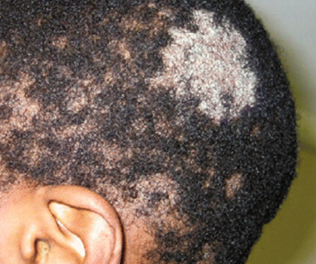
6
Tinea capitis (adults)
DESCRIPTION
Round of patchy bald areas with scales and stumps of broken off hair.
CHANGES
Fluconazole for Tinea capitis in adults AMENDED from 200 mg daily for 6 weeks to 200 mg weekly for 6 weeks
REASON
Fluconazole 200 mg weekly is as effective as 200 mg daily

Slide 7
7
THANK YOU

