Slide 1
Person Under Investigation for COVID-19
This is a person to be tested for COVID-19
Persons with acute respiratory illness with sudden onset of at least one of the following:
Cough
Sore throat
Shortness of breath
Fever (= or > 38 degrees Celsius measured) or history of fever (subjective) irrespective of admission status

Slide 2
Persons at highest risk for COVID-19 (1)
Persons at a highest risk are those who have an acute respiratory illness and who, in the 14 days prior to onset of symptoms, met at least one of the following epidemiological criteria:
Were in close contact (1) with a confirmed (2) or probable case (3) of SARS-CoV-2 infection; or
Had a history of travel to areas with local transmission of SARS-CoV-2; (NB Affected countries will change with time, consult NICD website for current updates); or
Worked in, or attended a health care facility where patients with SARS-CoV-2 were being treated (4); or
Admitted with severe pneumonia of unknown aetiology
Notes:
(1) Close contact: A person having had face-to-face contact (≤1 meter) or in a closed space with a COVID-19 case for at least 15 minutes. This includes, amongst others, all persons living in the same household as a COVID-19 case and, people working closely in the same environment as a case. A healthcare worker or other person providing direct c are for a COVID-19 case, while not wearing recommended personal protective equipment or PPE (e.g., gowns, gloves, NIOSH-certified disposable N95 respirator, eye protection). A contact in an aircraft sitting within two seats (in any direction) of the case, travel companions or persons providing care, and crew members serving in the section of the aircraft where the case was seated.
(2) Confirmed case: A person with laboratory confirmation of SARS-CoV-2 infection (using an RT-PCR assay), irrespective of clinical signs and symptoms. Symptomatic cases are considered infectious from 2 days before symptom onset to 14 days after symptom onset.
(3) Probable case: A PUI for whom testing for SARS-CoV-2 is inconclusive (the result of the test reported by the laboratory) or who tested positive on a pan -coronavirus assay.
(4)Working in a health care facility includes healthcare workers as well as administrative and support staff such as cleaning staff

Slide 3
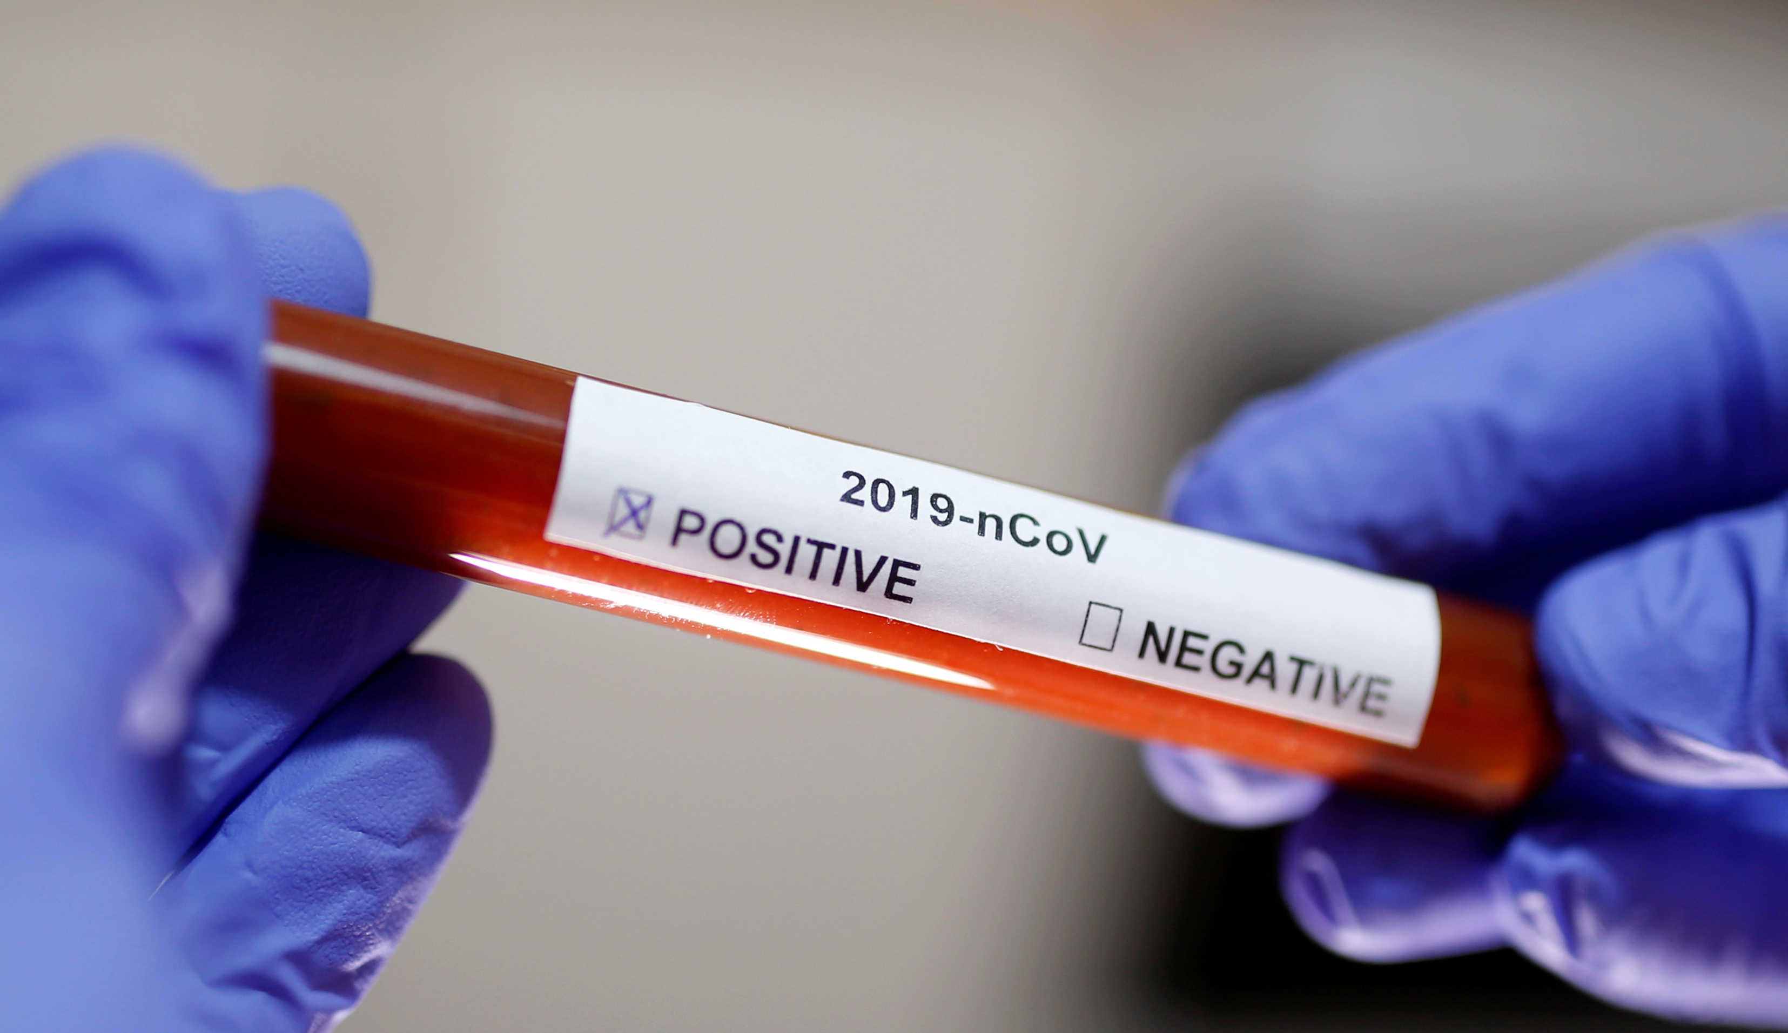
Management of suspected COVID-19
HCW to use N95 respirator and cover eyes – especially when taking a specimen or performing an aerosol generating procedure)
Use the screening questionnaire
If screening is positive, give the patient a medical/surgical mask
Direct the patient to a separate area, preferably isolation room if available
Educate the patient on how the cover the nose and mouth while coughing or sneezing (flexed elbow may be used)
Educate the patient on hand hygiene
Early initiation of supportive therapy may be required
Limit patient’s movements in the facility

Slide 4
Laboratory Diagnosis
Polymer Chain Reaction (PCR method) used
GeneXpert will be used in near future
Samples to be sent are: upper respiratory tract samples (nasopharyngeal and oropharyngeal swabs in universal transport medium) or lower respiratory tract samples if possible (sputum, tracheal aspirates, bronchoalveolar lavage fluid)
Notes:
Antibody tests not yet defined and should not be used at this point in time.

