Slide 1
1
Chapter 13: Immunisation
NATIONAL DEPARTMENT OF HEALTH
AFFORDABLE MEDICINES
ESSENTIAL MEDICINES PROGRAMME
PRIMARY HEALTHCARE GUIDELINES 2018

Slide 2
2
EVIDENCE
Please access the National Essential Medicines List Committee (NEMLC) report for detailed evidence (including rationale, references and costings) informing decision-making on medicine addition, amendments and deletions:
http://www.health.gov.za/index.php/standard-treatment-guidelines-and-essential-medicines-list/category/285-phc
DISCLAIMER
This slide set is an implementation tool and should be used alongside the most recently published STG available on the EML Clinical Guide Application. This information does not supersede or replace the STG itself.

Slide 3
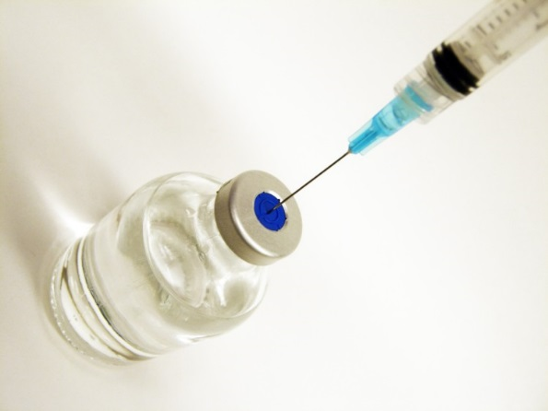
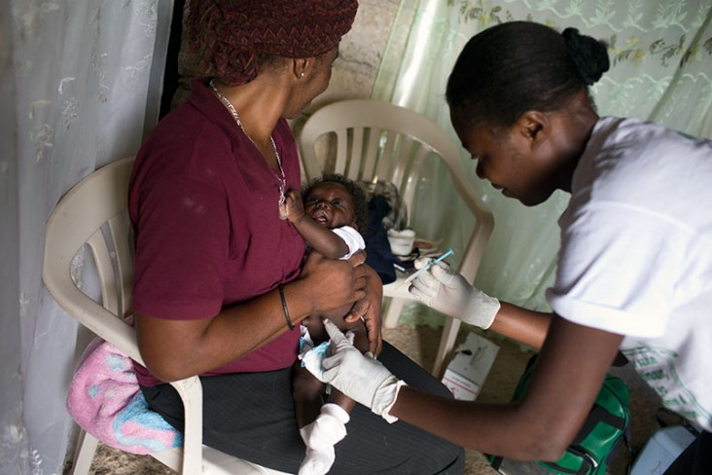
3
Measles vaccine
CHANGES
Measles vaccine currently on tender is given subcutaneously (measles vaccine, IM no longer manufactured).
Now given at 6 months AND 12 months.
REASON
Alignment with EPI schedule
Note: Measles vaccine is increasingly only available in combination with rubella vaccine. South Africa is likely to migrate to the combination vaccine in the next few years.

Slide 4
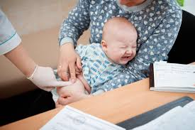
4
BCG
DESCRIPTION
Bacillus Calmette-Guérin
Protects against TB meningitis and miliary TB in children < 2 years of age.
CHANGES
Contra-indications to receiving BCG
Changed from ‘children with symptomatic HIV infection (Stage 3 and 4)’ to include ALL children known to be HIV-infected.
Note: BCG should not be delayed in HIV-exposed infants with unknown status.
REASON
Concern regarding risk of disseminated BCG disease in HIV-infected children.

Slide 5
5
Influenza Vaccination: indications
CHANGES
All women who are pregnant at the time of the annual immunisation campaign should be immunized.
Persons with the following risk factors may be offered immunisation during the annual campaign
HIV infection
Chronic cardiac or pulmonary conditions
Age > 65 years
Although it is recommended that healthcare workers are vaccinated against influenza, they will not be provided with publically funded vaccines unless they fall within any of the designated high risk groups
REASON
Alignment with NDoH/NICD/NHLS: Healthcare worker’s handbook on influenza.

Slide 6
6
Influenza Vaccination: dosage
CHANGES
Children 6 months up to 3 yrs:
0.25mL IM, 2 doses ≥ 4 weeks apart during first year of immunisation, thereafter one dose per annum.
Children 3 – 9 yrs:
0.25mL IM, 2 doses ≥ 4 weeks apart during first year of immunisation, thereafter one dose per annum.
REASON
Children aged 6 months through 8 years:
- require 2 doses of influenza vaccine (administered ≥ 4 weeks apart) during their first season of vaccination to optimize response
- a single dose may be insufficient for an adequate immune response in young children who have not been exposed to natural influenza infection.

Slide 7
THANK YOU

