Slide 1
1
Chapter 16: Mental health care
NATIONAL DEPARTMENT OF HEALTH
AFFORDABLE MEDICINES
ESSENTIAL MEDICINES PROGRAMME
PRIMARY HEALTHCARE GUIDELINES 2018

Slide 2
2
EVIDENCE
Please access the National Essential Medicines List Committee (NEMLC) report for detailed evidence (including rationale, references and costings) informing decision-making on medicine addition, amendments and deletions:
http://www.health.gov.za/index.php/standard-treatment-guidelines-and-essential-medicines-list/category/285-phc
DISCLAIMER
This slide set is an implementation tool and should be used alongside the most recently published STG available on the EML Clinical Guide Application. This information does not supersede or replace the STG itself.

Slide 3
New sections added
SECTION | CONDITION | MEDICINE MANAGEMENT | MEDICINE ADDED
16.2.2 | Neuroleptic malignant syndrome Moved to its own section | No | n/a
16.6 | Psychiatric patients - general monitoring and care New section | Yes | Folic acid, oral*
16.8.1 | Intellectual disability New section | No | n/a
16.8.2 | Older patients (≥ 45 years) New section | No | n/a
16.8.3 | Sexual health and sexuality New section | No | n/a
16.8.4 | Maternal mental health New section added to obstetrics chapter | No | n/a
*For women of reproductive age groups who require to be on valproic acid or carbamazepine to reduce potential of Neural tube defects in the event of unplanned pregnancy.

Slide 4
4
Anxiety disorders
DESCRIPTION
Emotional response to an apparent stress.
Presenting symptoms may be physical (muscle tension, headaches, panic attacks) and/or psychological (excessive worry, mood changes, distress, difficulty concentrating).
CHANGES
Psychotherapy, ADDED
Fluoxetine, oral: AMENDED as first line treatment
SSRIs, oral, ADDED, as a therapeutic group (citalopram, escitalopram, sertraline) – for second line treatment.
Diazepam, oral: RETAINED for severe panic attacks.
REASON
Psychotherapy effective in managing anxiety
Fluoxetine as first line for depression and anxiety in all patients as it is:
Well studied
Effective in depression and generalised anxiety for adults, adolescents HIV infected patients

Slide 5
5
Depression
DESCRIPTION
Characterised by a low mood and/or a reduced capacity to enjoy life
May present with: mood symptoms, loss of interest or pleasure (anhedonia), physical symptoms, psychological or cognitive symptoms
REASON
Dosing: reduced dosing of fluoxetine at initiation (alternate days) to lessen side effects of increased agitation
Duration: systematic review showed that prolonged treatment with antidepressants reduced odds of relapse by 70%.
Second line added as an option for those not tolerating fluoxetine
CHANGES
Fluoxetine, oral: AMENDED as first line treatment
SSRIs, oral, ADDED, as a therapeutic group (citalopram, escitalopram, sertraline) – for second line treatment.
Duration of SSRI therapy AMENDED

Slide 6
6
Acute psychosis
DESCRIPTION
A clinical state characterised by recent onset of psychotic symptoms such as: hallucinations, delusions, disorganised or illogical speech, agitation or bizarre behaviour and extreme and labile emotional states.
CHANGES
For violent patients or those known with schizophrenia, known to have used antipsychotics previously:
Zuclopenthixol acetate, IM, DELETED
REASON
No advantage of zuclopenthixol acetate over haloperidol.
There have been reports of associated neuroleptic malignant syndrome and zuclopenthixol acetate has a long half-life.

Slide 7
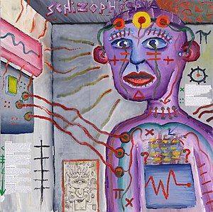
7
Chronic psychosis
DESCRIPTION
Schizophrenia is the most common chronic psychotic disorder.
There is a loss of contact with reality and is characterised by:
positive symptoms, delusions, hallucinations and thought process disorder
negative symptoms, blunting of affect, social withdrawal
mood symptoms such as depression may be present
CHANGES
Long-term depot therapy where adherence problem, or patient preference:
Fluphenazine, IM, DELETED
REASON
Fluphenazine discontinued.
Alternative agents:
flupenthixol decanoate, IM and zuclopenthixol decanoate, IM are recommended in the STG.

Slide 8
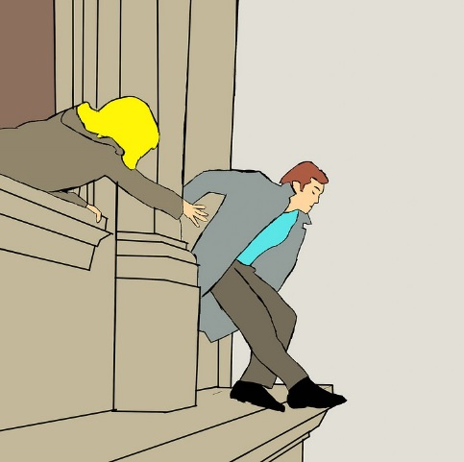
8
SUICIDE RISK ASSESSMENT
DESCRIPTION
Suicide is the act of deliberately killing oneself.
In addition to key risk factors (like history of mental illness, history of abuse, substance abuse, family history, LGBT groups adolescents), there are 5 important components when assessing suicide: ideation (thoughts), intent, plan, access to lethal means, and history of past suicide attempts.
CHANGES
Suicide risk tools were REMOVED and replaced with text creating awareness of the risk of suicide with referral as required.
REASON
Insufficient evidence to predict the risk of suicide using various tick-box tools. The best predictive risk factor for assessing suicide attempts is a previous suicide attempt.

Slide 9
THANK YOU

