Slide 1
medical certification of cause of death – online training
Dr Pam Groenewald and Dr Oluwatoyin Awotiwon
Burden of Disease Research Unit
SA Medical Research Council
National Department of Health webinar
4 June 2021

Slide 2
outline
Importance of cause of death (COD) statistics
Challenges with SA COD data
Instructions for medical certification of cause of death including COVID-19
Common certification errors

Slide 3
Notes:
Mortality data is used to indicate community health concerns and priorities. In these
graphs you can see deaths by disease category for males and females in South Africa
in 2012. HIV and TB account for 33% of deaths in both males and females.
Injuries account for 14.4% of deaths amongst males versus only 4.4% in females.
Cardiovascular deaths account for 22% amongst women and 15.2% amongst men.

Slide 4
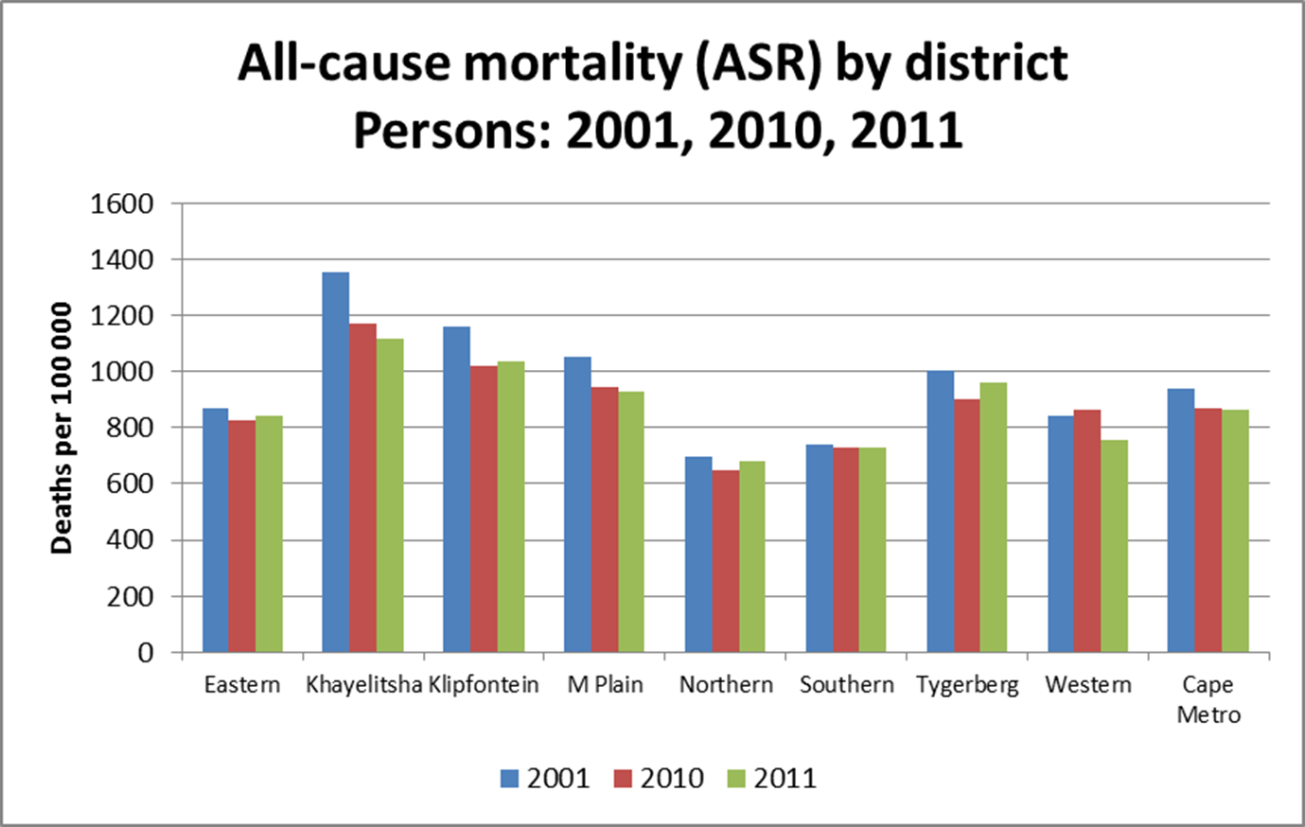
CAUSE OF DEATH: MORTALITY DATA USES
Notes:
Mortality data can show inequities between geographical areas – Khayelitsha has all cause mortality rates almost double those for Norther and Southern

Slide 5
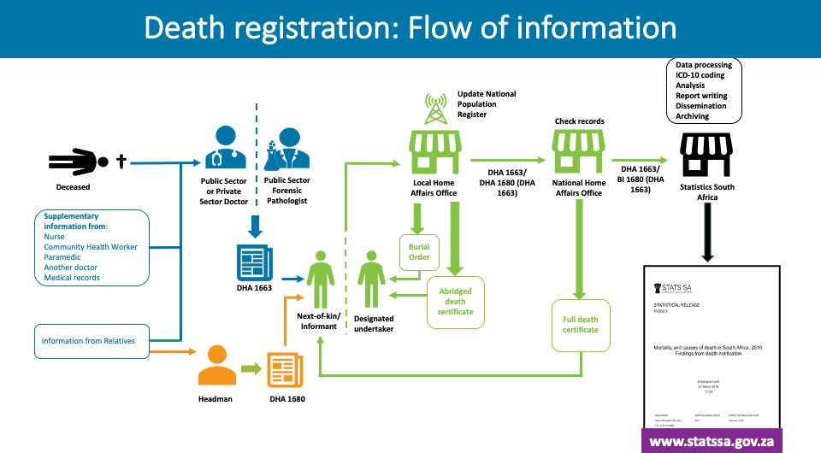
Notes:
Now that we’ve discussed the importance and legal status of cause of death reporting, let’s have a look at the official mortality statistics system and the role of the medical doctor for improving quality of death certification in the country.
When someone dies, there are a few people that could play an important role to assist the doctor – who is completing the Death Notification Form - to obtain the necessary information to report on the cause of death.
This include other members of the healthcare team, such as the nurse caring for the person, the community health worker who regularly visited the person at home, the paramedics who provided emergency care prior to admission to hospital, or the doctor who usually looked after the person. Clinic or hospital medical records may also provide information on the deceased’s medical history. Then there is the family, who may be able to provide valuable information.
In South Africa, medical doctors in public or private health facilities, and forensic pathologists at forensic mortuaries, certify deaths on the DHA-1663 Death Notification Form.
Headman in traditional areas can also complete a form to certify death: the DHA-1680 Form.
These forms are taken by the funeral undertaker or a relative of the deceased to a local or regional Home Affairs office, where the death is registered prior to burial.
The Home Affairs office will update the population register and issue a burial order and an abridged death certificate to the funeral undertaker or relative.
From here the DHA-1663 form is sent to the National Department of Home Affairs in Pretoria, where they are checked and a Full death certificate issued.
The DHA-1663 form is finally sent to Stats SA for ICD-10 coding of cause of death, analysis, reporting and archiving.
An annual Mortality and Cause of death report is issued by Stats SA and can be downloaded from the Stats SA website.

Slide 6
Challenges with cause of death data
    Misclassification of HIV deaths to other causes
    High proportion of deaths with ill-defined (unusable) causes
    Injury mortality profile inaccurate

Slide 7
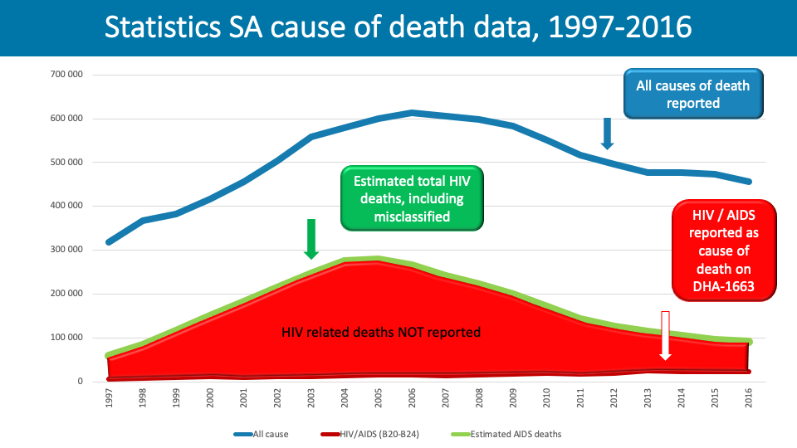
lenges
Notes:
The blue line shows the number of deaths reported annually between 1997 until
2016.
The red line shows the number of HIV-related deaths reported on the death
notification form over the same period…
whereas the green line show our estimated number of HIV-related deaths.
The gap between red and green line reflects deaths that should have been reported
as HIV-related.
The consequence of inaccurate statistics on HIV-related deaths was that the
government had reason to delay rolling out anti-retroviral treatment resulting an
estimated 1 million deaths that could have been averted.

Slide 8
LEADING CAUSES OF DEATH IN SOUTH AFRICA, 2012
SOUTH AFRICAN NATIONAL BURDEN OF DISEASE STUDY 2012 |  |  |  | STATISTICS SOUTH AFRICA 2012
Rank | Cause of death | Number | % of all deaths | Rank | Cause of death | Number | % of all deaths
1 | HIV/AIDS | 153661 | 29.1 | 1 | Ill-defined and unknown causes | 65033 | 13.5
2 | Cerebrovascular disease | 39830 | 7.5 | 2 | Tuberculosis | 47472 | 9.9
3 | Lower respiratory infections | 25977 | 4.9 | 3 | Influenza and pneumonia | 26385 | 5.5
4 | Ischaemic heart disease | 24969 | 4.7 | 4 | Cerebrovascular disease | 23994 | 5.0
5 | Tuberculosis | 23817 | 4.5 | 5 | Other forms of heart disease | 21612 | 4.5
6 | Diabetes mellitus | 18894 | 3.6 | 6 | Diabetes mellitus | 21230 | 4.4
7 | Hypertensive heart disease | 18755 | 3.5 | 7 | HIV/AIDS | 18663 | 3.9
8 | Interpersonal violence | 18741 | 3.5 | 8 | Hypertensive diseases | 16195 | 3.4
9 | Road injuries | 17597 | 3.3 | 9 | Other viral diseases | 15057 | 3.1
10 | Diarrhoeal diseases | 16349 | 3.1 | 10 | Intestinal infections | 14948 | 3.1
Top 10 causes |  | 358590 | 67.8 | Top 10 causes |  | 270589 | 56.3
Total |  | 528947 | 100 | Total |  | 480476 | 100
Source: Own analysis of Statistics South Africa data
Notes:
This slide shows the leading causes of death from Stats SA raw data and from the SANBD study for 2012. The data source for the study is the COD data released by Stats SA. This is based on what doctors record on death notification forms and cannot be taken at face value.
As you can see, the leading cause in 2012 in the raw data was the ill defined and unknown category. This refers to deaths without a specified underlying disease specified but rather signs and symptoms such as headache or respiratory arrest.
Our previous work has shown that there is misclassification of causes in particular for HIV/AIDS. You will see only 3.9% of the 2012 deaths were recorded with HIV/AIDS as the underlying cause of death in the raw data whilst we calculated that it was nearer to 30%.

Slide 9

Retroviral disease
RVD

Slide 10
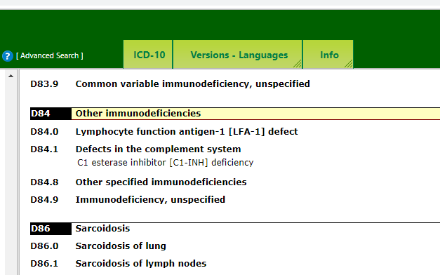
Immunocompromised
Immunodeficiency

Slide 11
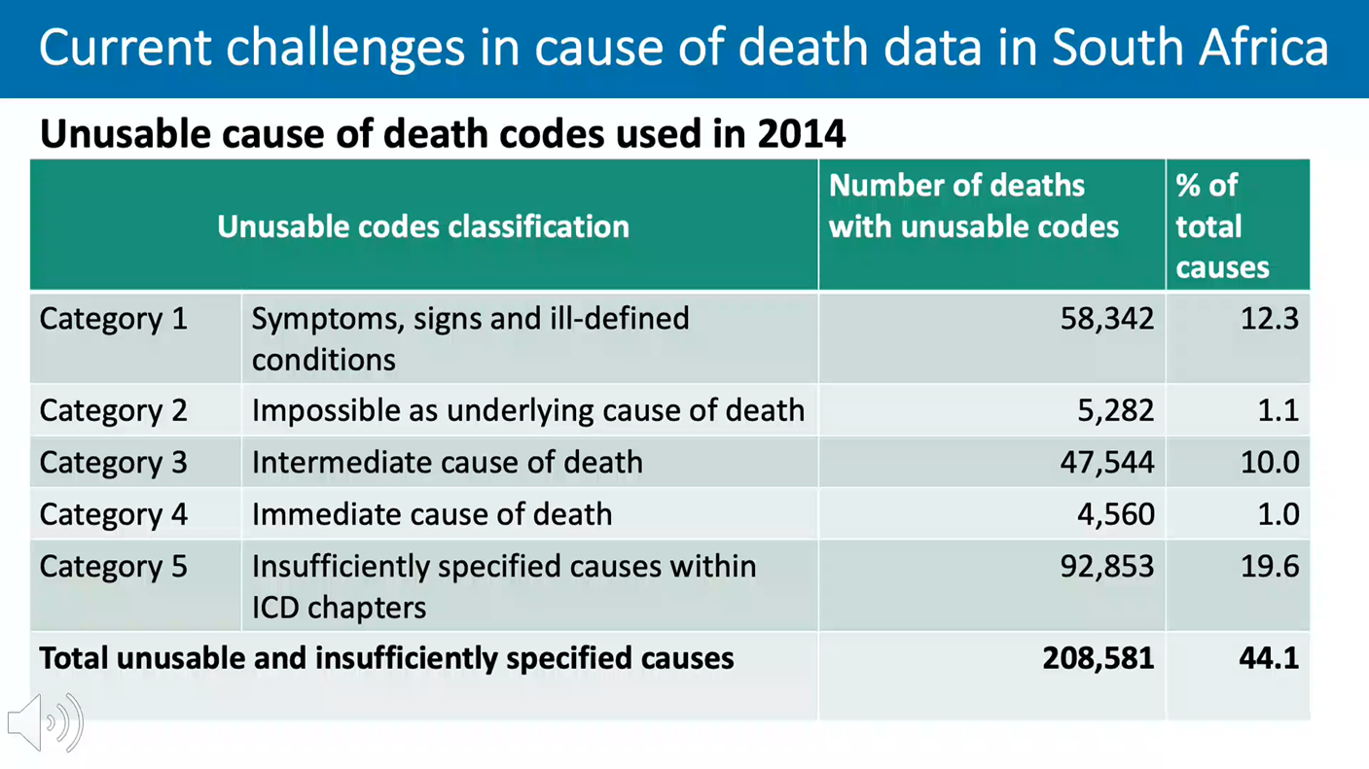
Notes:
In 2014 44% of causes were unusable or insufficiently specified. Almost half of these were insufficiently specified causes such as cancer with no primary site. 12.3% were symptoms and signs such as cough, tachycardia, abdominal pain where no cause is determined. 11% due to immediate or intermediate causes such as heart failure, renal failure, dehydration etc. which could be caused by multiple different underlying conditions. 1 % due to invalid causes of death such as headache or warts.

Slide 13
SA COD data not fit for purpose
  Reflects what is written on the death certificate
  Possible reasons
Lack of training in death certification
Importance/uses of COD not well understood
Lack of access to medical records
SA Legislation conflicts with WHO guidelines
  Inquest Act : anyone who preempts the finding of an inquest can be subject to a fine or imprisonment
  Thus, many FP do not state manner of death on MCCD
  Manner of death not indicated on DHA-1663

Slide 14
Medical certification of cause of death
Instructions and common errors
Notes:
Having highlighted two of the main problems with SA cause of death data lets look at the instructions for medical certification of cause of death and common errors in certification

Slide 15
Notes:
We collect cause of death information in order to try and prevent premature deaths.
In order to do this, it is necessary to break the chain of events leading to death.
The most effective way is to prevent the precipitating or underlying cause of death.
The Underlying Cause of Death is defined by the World Health Organization as “the
disease or injury which initiated the chain of morbid events leading directly to death
or the circumstances of the accident or violence which produced the fatal injury.”

Slide 16
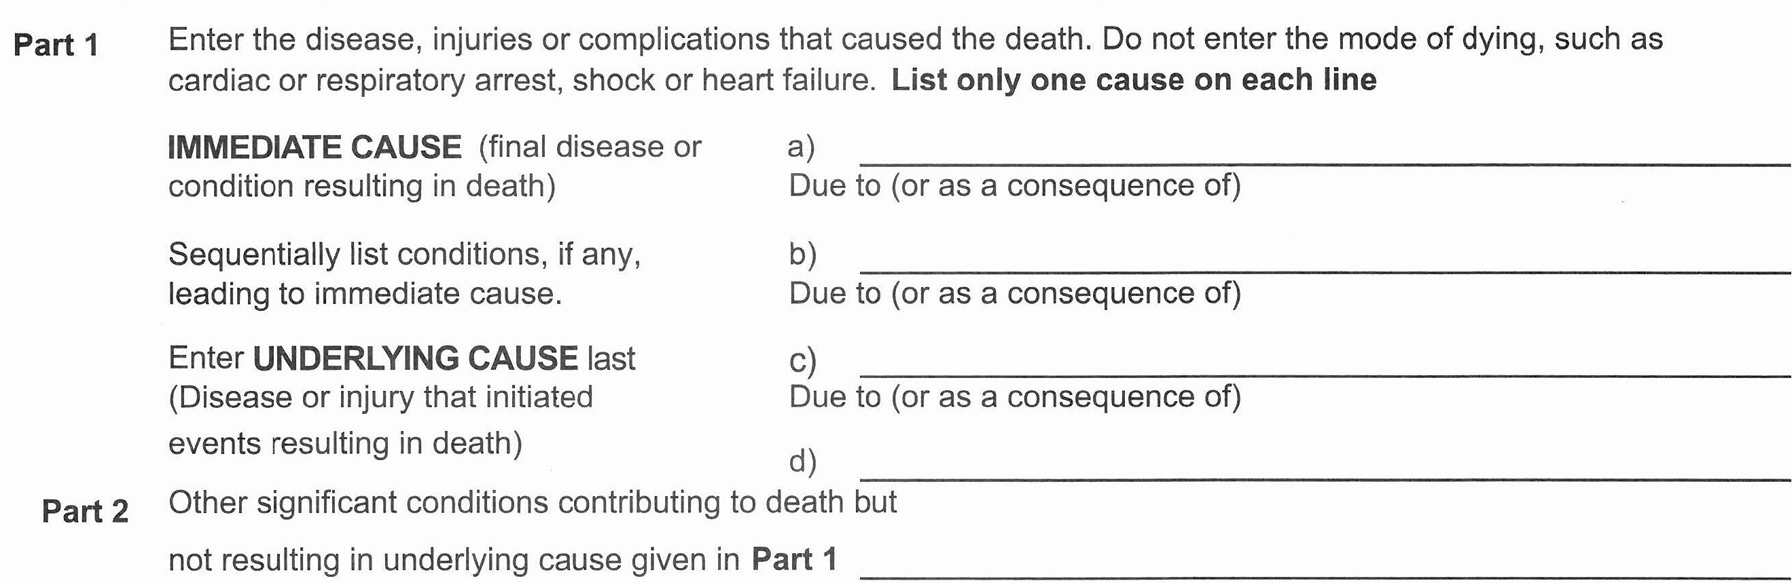
International Medical Certificate of Cause of Death Form
Facilitate identification of underlying cause of death, especially where multiple conditions are present
Part 1: Chain of events or causal sequence leading directly to death
Immediate cause
Antecedent cause
Antecedent cause
Underlying cause on lowest completed line
Part 2: Co-existing conditions which contributed to death, but do not fit into causal sequence in Part 1.
Notes:
The International medical certificate of cause of death was designed to facilitate the
identification of the underlying cause of death when multiple conditions exist at time
of death. For this reason it is divided into 2 parts.
Part 1 is designed to capture the chain of events or causal sequence leading directly
to death and makes provision for up to four conditions - lines (a) to (d).
The immediate cause of death or condition leading directly to death is captured on
the top line followed in chronological/pathophysiological sequence by any
antecedent cause on the line below the immediate cause. The underlying causes of
death – that is the condition that initiated the sequence of events leading to death -
should be captured on the lowest completed line.
Part 2 is designed to capture any co-existing conditions at the time of death, which
contributed to the death, but do not fit into the causal sequence in Part 1.
Conditions reported in Part 1 and Part 2 should NOT include symptoms, signs and
modes of dying.

Slide 17
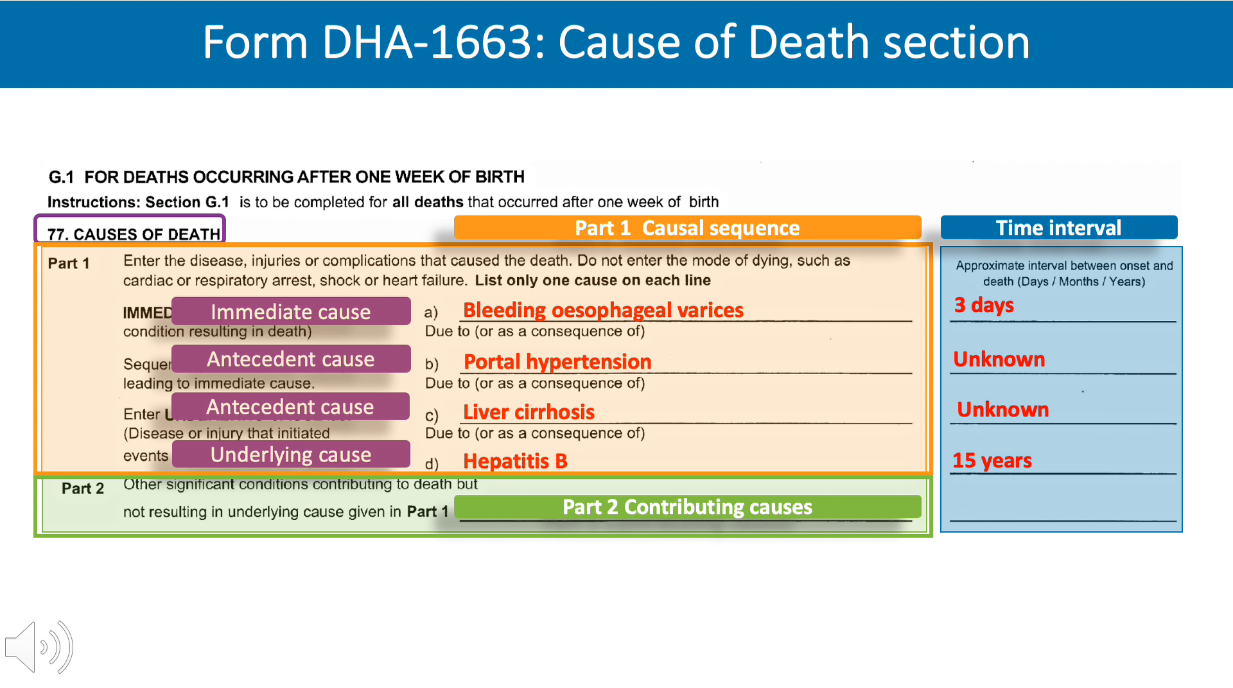
A 50 year female was admitted vomiting blood and found to have bleeding oesophageal varices. Further investigation revealed portal hypertension and liver cirrhosis. She had a history of hepatitis B 15 years ago. She died 3 days after admission.
Notes:
Let’s use this case study to complete the cause of death section on the DHA-1663
form. As mentioned earlier the cause of death section consists of two parts:
Part 1, with lines (a) to (d), which includes the causal sequence that directly caused
the death, and
Part 2, which contains any other significant conditions contributing to death, but are
not part of causal sequence.
The causal sequence leading to death is entered in Part 1 with the immediate cause of death entered in line (a). This line must always be filled in.
If the direct cause of death was a consequence of another disease or condition, this
antecedent cause should be entered in Part 1 line (b).
If more than one line is completed, each condition must be a cause of the condition
above it. There must be a pathophysiological causal sequence. The initiating cause in
the sequence is the underlying cause of death and should be reported on the lowest
used line in Part 1. Always use consecutive lines, starting at Part 1 line a). Never
leave blank lines between filled in lines. If there is only one cause of death, it is
entered at Part 1 line (a) and the subsequent lines are left blank. Enter only one
disease, condition, event, or injury per line.
Other significant conditions or risk factors that contributed to the death, but do not
fit into the causal sequence, are entered in Part 2. More than one condition can be entered on this line, but should be listed in order of importance. Signs and symptoms and or modes of dying should not be reported in either Part 1 or Part 2.
The time interval between the onset of the condition and death is entered on the right of Part 1 and Part 2 to ensure that the causal sequence is in the correct order. If the time interval is unknown, write “unknown”. The duration of the underlying cause should be the longest. If more than 1 condition is entered in Part 2, insert the duration in brackets after each condition.

Slide 18
HIV/AIDS
In HIV positive cases where the immediate cause of death is a condition known to be associated with HIV, or an AIDS defining condition, HIV related disease or HIV/AIDS should be reported in Part I as UCOD (on lowest completed line).
Your best medical opinion is sufficient
Do not use euphemisms for HIV such as RVD, retrovirus, immuno-compromised, immune deficiency syndrome – these will not be coded to HIV

Slide 19
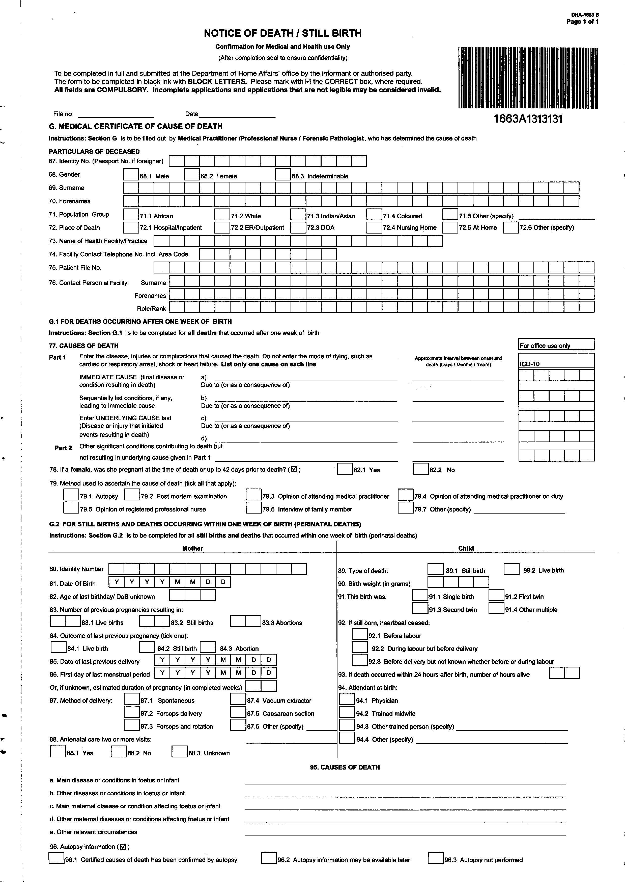
Case scenario
Female of 30 yrs known with HIV for 2 years. Defaulted ARVs 1 year ago. Presented very ill with 4 month history of loss of weight, coughing productive sputum and increasing breathlessness. Sputum+ for TB. TB Rx commenced in hospital but died 3 days after admission.
Tuberculosis
4 months
HIV related disease
2 years

Slide 20
injuries
WHO ICD-10 coding guidelines include Manner of death on the MCCD to enable accurate coding of injuries (external causes)
  Disease
  Accident
  Intentional self harm
  Assault
  Legal intervention / War
  Could not be determined
  Pending investigation
  Unknown

Slide 21
injuries
WHO ICD-10 coding guidelines for injuries with unknown intent default to ACCIDENTAL
Where gunshot wound is stated on DHA-1663 with no intent stated will be coded to accidental gunshot as cause of death

Slide 22
International form of MCCD
Administrative data
Frame A: Causes of death
Frame B: Other medical data including Manner of Death

Slide 23
Causes of death

Slide 24
Manner of death

Slide 25
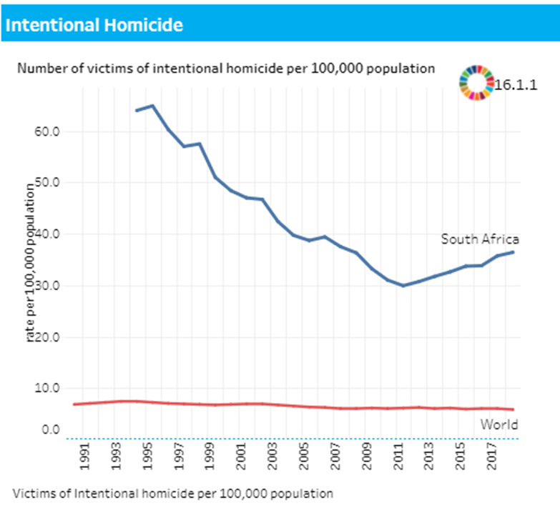
Injury burden in SA vs Global
All injuries
Global: 55.6 per 100 000
SA: 101.6 per 100 000
Transport injuries
Global: 16.5
SA: 35.7
Homicide
Global: 5.4 per 100 000
SA: 34.4 per 100 000
5th highest homicide rate

Slide 26
Definition of a COVID-19 related death (WHO 2020)
Death due to COVID-19
  A death resulting from an illness compatible with COVID-19, in a probable or confirmed COVID-19 case, unless there is a clear alternative cause of death unrelated to COVID (trauma).
  The UCOD of a person who died due to COVID-19 disease (laboratory confirmation or clinical grounds only) should be stated as COVID-19 in Part 1
  Report co-morbidities in Part 2
  No period of complete recovery between illness and death
COVID-19-related death
  Deaths in COVID-19 positive persons which are due to accidental/incidental causes (eg. trauma), or natural causes where COVID-19 was not identified as the UCOD (eg. Cases with severe, advanced pre-existing disease).
  If COVID-19 contributed to the death but was not the UCOD, report COVID-19 in Part 2

Slide 27
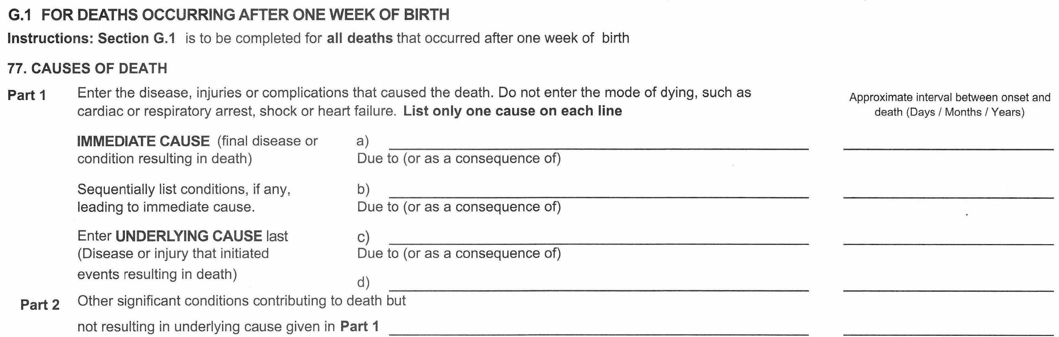
Example of death due to COVID-19 (confirmed)
A 55 year old female develops symptoms suggestive of COVID-19 and is admitted for increasing
SOB. A COVID-19 test is positive. She develops bilateral pneumonia and becomes progressively worse over the next 8 days. She goes into acute respiratory distress syndrome and dies two days later.
Acute respiratory distress syndrome
2 days
Pneumonia
10 days
Confirmed COVID-19
10 days

Slide 28
Example of death due to COVID-19 (suspected)
A 55 year old female is admitted for an acute respiratory infection. She develops bilateral pneumonia and becomes progressively worse over the next 8 days. During this time a COVID-19 test is taken but the results are delayed. She goes into acute respiratory distress syndrome and dies two days later before the test result is available.
Acute respiratory distress syndrome
2 days
Pneumonia
10 days
Suspected COVID-19
10 days

Slide 29
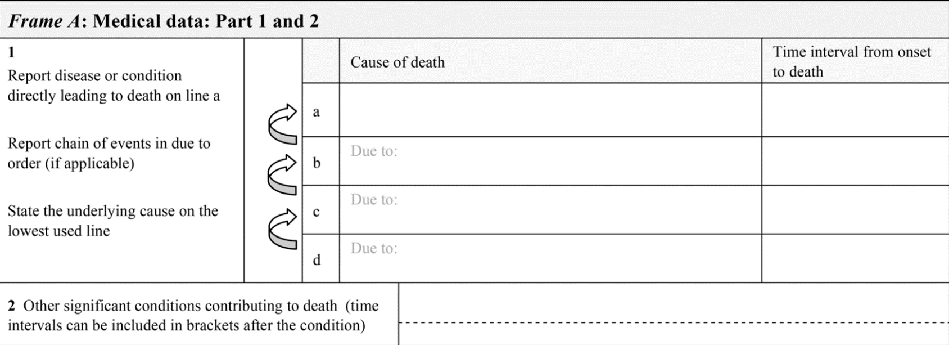
Example of death due to COVID-19 (confirmed)
An 8-year-old female with uncontrolled insulin-dependent diabetes mellitus (diagnosed 4 years ago), was admitted for diabetic ketoacidosis. Baseline gas suggested significant pneumonic process, with inability to effectively compensate for the metabolic acidosis.
She required intubation and ventilation on admission (subsequently weaned off the ventilator), and a broad-spectrum antibiotic was administered intravenously. Admission blood and urine cultures were negative and HbA1c >18.5%.
On day 2 of admission, COVID-19 swab was done, and the result was positive. She had a respiratory collapse on the evening of the 3rd hospital day with CXR revealing bilateral extensive infiltrates, PO2: 65 mmHg, FiO2: 0.9, PF ratio 72 indicative of ARDS. She was intubated and ventilated in an isolation cubicle, and a repeat nosocomial sepsis work up yielded negative cultures. She developed pneumothorax and pneumo-mediastinum and despite treatment her condition deteriorated. She died on day 7 of admission.
Acute respiratory distress syndrome
7 days
Confirmed COVID-19
7 days
Insulin dependent diabetes mellitus (4 years)
Notes:
The immediate cause of death in this patient is Acute respiratory distress syndrome, reported on line A of Part 1.
COVID-19 is the underlying cause of death, so it is reported on the lowest used line (line B) of Part 1.
Confirmed COVID-19 should be written on the death notification form when laboratory confirmation is available.
Insulin-dependent diabetes mellitus could have contributed to the death but is not part of the causal sequence in Part 1. Thus, it is reported in Part 2.
Pneumothorax and pneumo-mediastinum are not diseases and should not be reported on the death certificate.

Slide 30
Example of COVID-19-related death (confirmed) death due to accidental causes OR natural causes where COVID-19 is not the UCOD
A 15-year-old known patient with aplastic anaemia of undetermined cause diagnosed 5 months presented to hospital with loss of consciousness. CT brain suggestive of acute hypertensive encephalopathy. Subsequently developed respiratory distress and clinical pneumonia and was commenced on high-flow oxygen. Laboratory results showed severe pancytopaenia.
On day 9 of admission, blood cultured yielded ESBL Proteus vulgaris, Klebsiella pneumoniae, Enterococcus faecalis, and COVID-19 swab was negative. A repeat COVID-19 swab was positive on day 17. Repeat blood cultures were negative. Patient remained pyrexial with worsening respiratory distress and could not be placed on ventilation due to severe neurological impairment and poor response of aplastic anaemia to therapy. He demised 3 days later.
Suspected nosocomial sepsis
20 days
Aplastic anaemia
5 months
Confirmed COVID-19 (days)
Notes:
The immediate cause of death in this patient is Suspected nosocomial sepsis, reported on line A of Part 1.
Aplastic anaemia is the underlying cause of death, so it is reported on the lowest used line of Part 1.
COVID-19 could have contributed to the death but is not part of the causal sequence in Part 1. Thus, it is reported in Part 2.
Confirmed COVID-19 should be written on the death notification form when laboratory confirmation is available.
Pancytopaenia is not a disease and should not be reported on the death certificate.

Slide 31
Example of COVID-19-related death
death due to accidental causes OR natural causes where COVID-19 is not the UCOD
A 20 year old male COVID-19 PUI was admitted with a severe head injuries due to an MVA, which occurred on his way home from the testing site. He was admitted to ICU for stabilization where he developed a subarachnoid haemorrage and died 24 hours later. In the meantime his COVID-19 test returned positive.
Subarachnoid haemorrhage
1 day
Head injury
1 day
Motor vehicle accident
COVID-19 confirmed

Slide 32
Example of COVID-19-related death
death due to accidental causes OR natural causes where COVID-19 is not the UCOD
A 65 year old male known with angina developed acute severe chest pain radiating into his left arm. He was admitted to hospital where he was treated for a myocardial infarction. A routine pre-admission test for COVID-19 was positive although he had no symptoms. After 2 days he became increasingly short of breath was diagnosed with heart failure. He died 6 days after admission.
Heart failure
1 day
Myocardial infarction
6 day
COVID-19 confirmed

Slide 33
Ill defined conditions are of no value
Organ failure (heart failure, renal failure)
  not acceptable as UCOD
  Report the disease that caused the organ failure
Symptoms and signs (chest pain, hypokalaemia, stridor)
  Do not report on death certificate
Mode /mechanism of dying
  physiological derangement that led to death
  Cardiac failure, renal failure, hypoxia, dehydration, sepsis
  May be written on the very first line, IF it is followed by a proper disease as underlying cause of death. But try to avoid it!
Unknown cause of death
  acceptable where insufficient info unless unnatural cause

Slide 34
Common errors: immediate cause no UCOD
Heart failure

Slide 35
Common errors: mode of dying no ucod
Cardiac arrest

Slide 36
Common errors:
> 1 cause per line in Part 1
Abbreviations
CCF, COPD, HPT, MI, DM II

Slide 37
Common errors: Incorrect sequence
Peritonitis
Strangulated femoral hernia
Bowel perforation

Slide 38

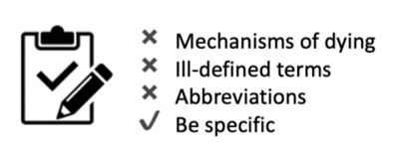
Approach to identifying and certifying cause of death
“What initiated the chain of events that led to death?”
Underlying cause of death
Physical/chemical influences
Sudden, unexpected death
Procedure-related death
Omission/commission
Disease
Natural
Unnatural
Underlying cause of death
Forensic pathology
Nature of the injury
Circumstances of the death
Manner of death
Place of occurrence
Causal sequence
Intermediate cause of death
Immediate cause of death
Contributing causes
Notes:
The following flow diagram summarises the approach to identifying and certifying the cause of death. Firstly, ask yourself, “What initiated the chain of events that led to death?” This will give you the underlying cause of death. Then ask yourself if the underlying cause of death is:
- Natural, due to disease
- or Unnatural? In other words, are there physical or chemical influences on the body, sudden unexpected death, procedure-related death or omission or commission? If the cause of death is “Natural”, then think about the causal sequence
– that is the intermediate and immediate cause of death, as well as the contributing causes. This will help you to determine the underlying cause of death.
Check that you:
•Do not mention mechanisms of dying
•Avoid ill-defined terms
•Avoid abbreviations, and
•that you have been as specific as possible, particularly for the site of cancer or infection.
If the death is as a result of Unnatural causes you should NOT complete a Death Notification Form, but refer the case to forensic pathology with a detailed referral letter explaining the, nature of the injury, circumstances of the death, manner of death and place of occurrence. They will then conduct a postmortem investigation which will determine whether the death was a homicide, suicide, accidental, natural or undetermined.
Deaths, due to falls and other injury-related conditions in the elderly, are not natural deaths and should be referred to Forensic Pathology Services. In the case of deaths, due to an injury which resulted from a medical condition, the injury supersedes the underlying medical condition that caused the injury. This is for classification purposes.

Slide 39
www.deathcertification.org
Notes:
In an attempt to address the lack of training of medical drs on proper death certification, we have launched a new free online course for doctors and medical students. Assessments are linked to Continuing Education Units including Ethics units. It can be found at the website showing on the slide.

